Slide 1
Freelance Forge
TEAM 3:
Asritha Pallapotu | Amar Gopal Kapalavai | Yugantkumar Gajera | Sai Aneesh |
Jensikumari Ishvarbhai Jasoliya | Venkata Puneeth Nannapaneni | Akhil Yadati | Syed Adnan |
Naveen Kumar Kukutla | Dhvani Dilipbhai Borda

Slide 2
Agenda
GitHub
Repo structure | Prerequisites | Installation
Code Snippets
Frontend | Backend
Deployment
Jenkins

Slide 3
Github URL:
https://github.com/P-Asritha/FreelanceForge

Slide 4
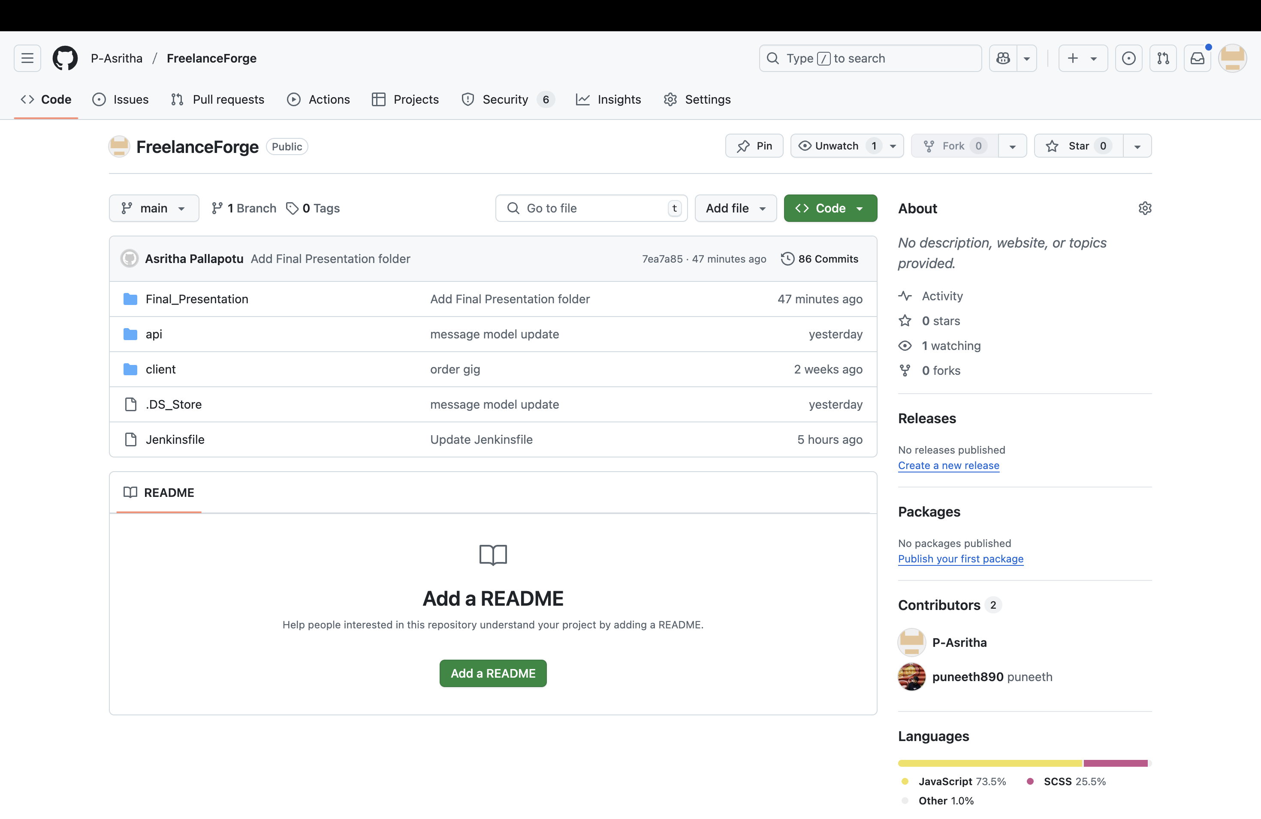
Repo Structure
Freelance Forge-Final-Presentation
Contains all the approved deliverables
and final documents
Freelance Forge - Frontend
Frontend - client repo
Freelance Forge-Backend
Backend - api repo

Slide 5
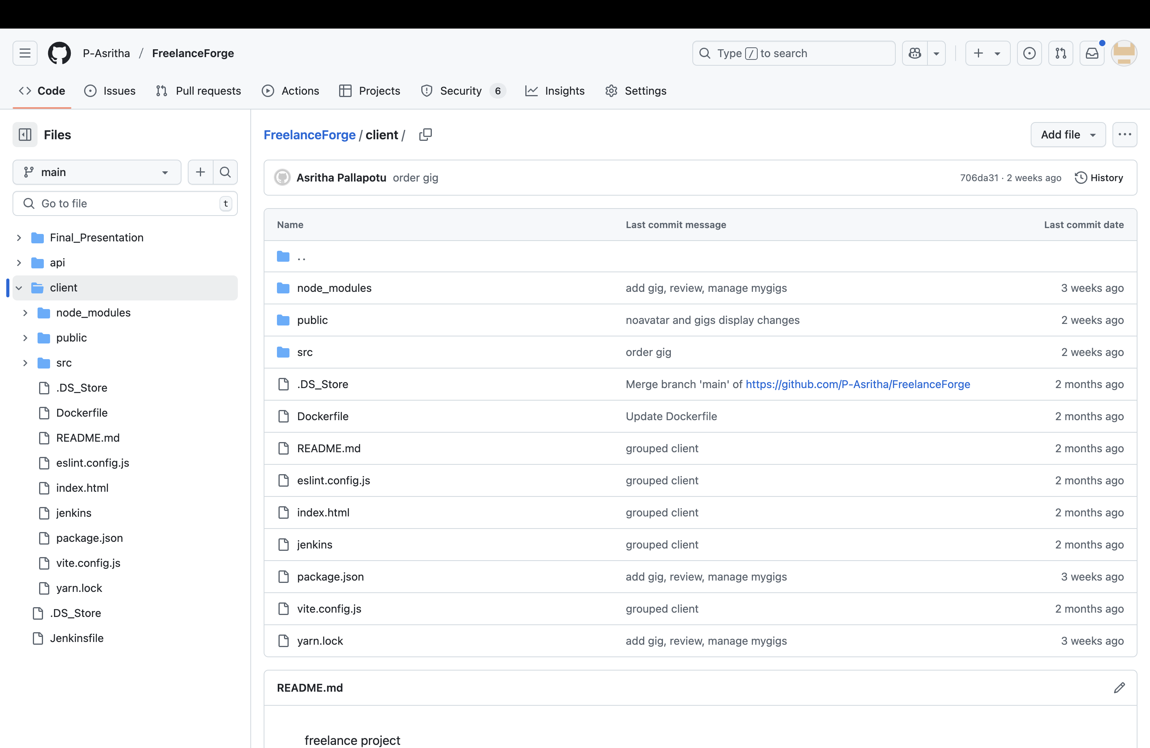
Repo Structure (Client - Frontend)

Slide 6
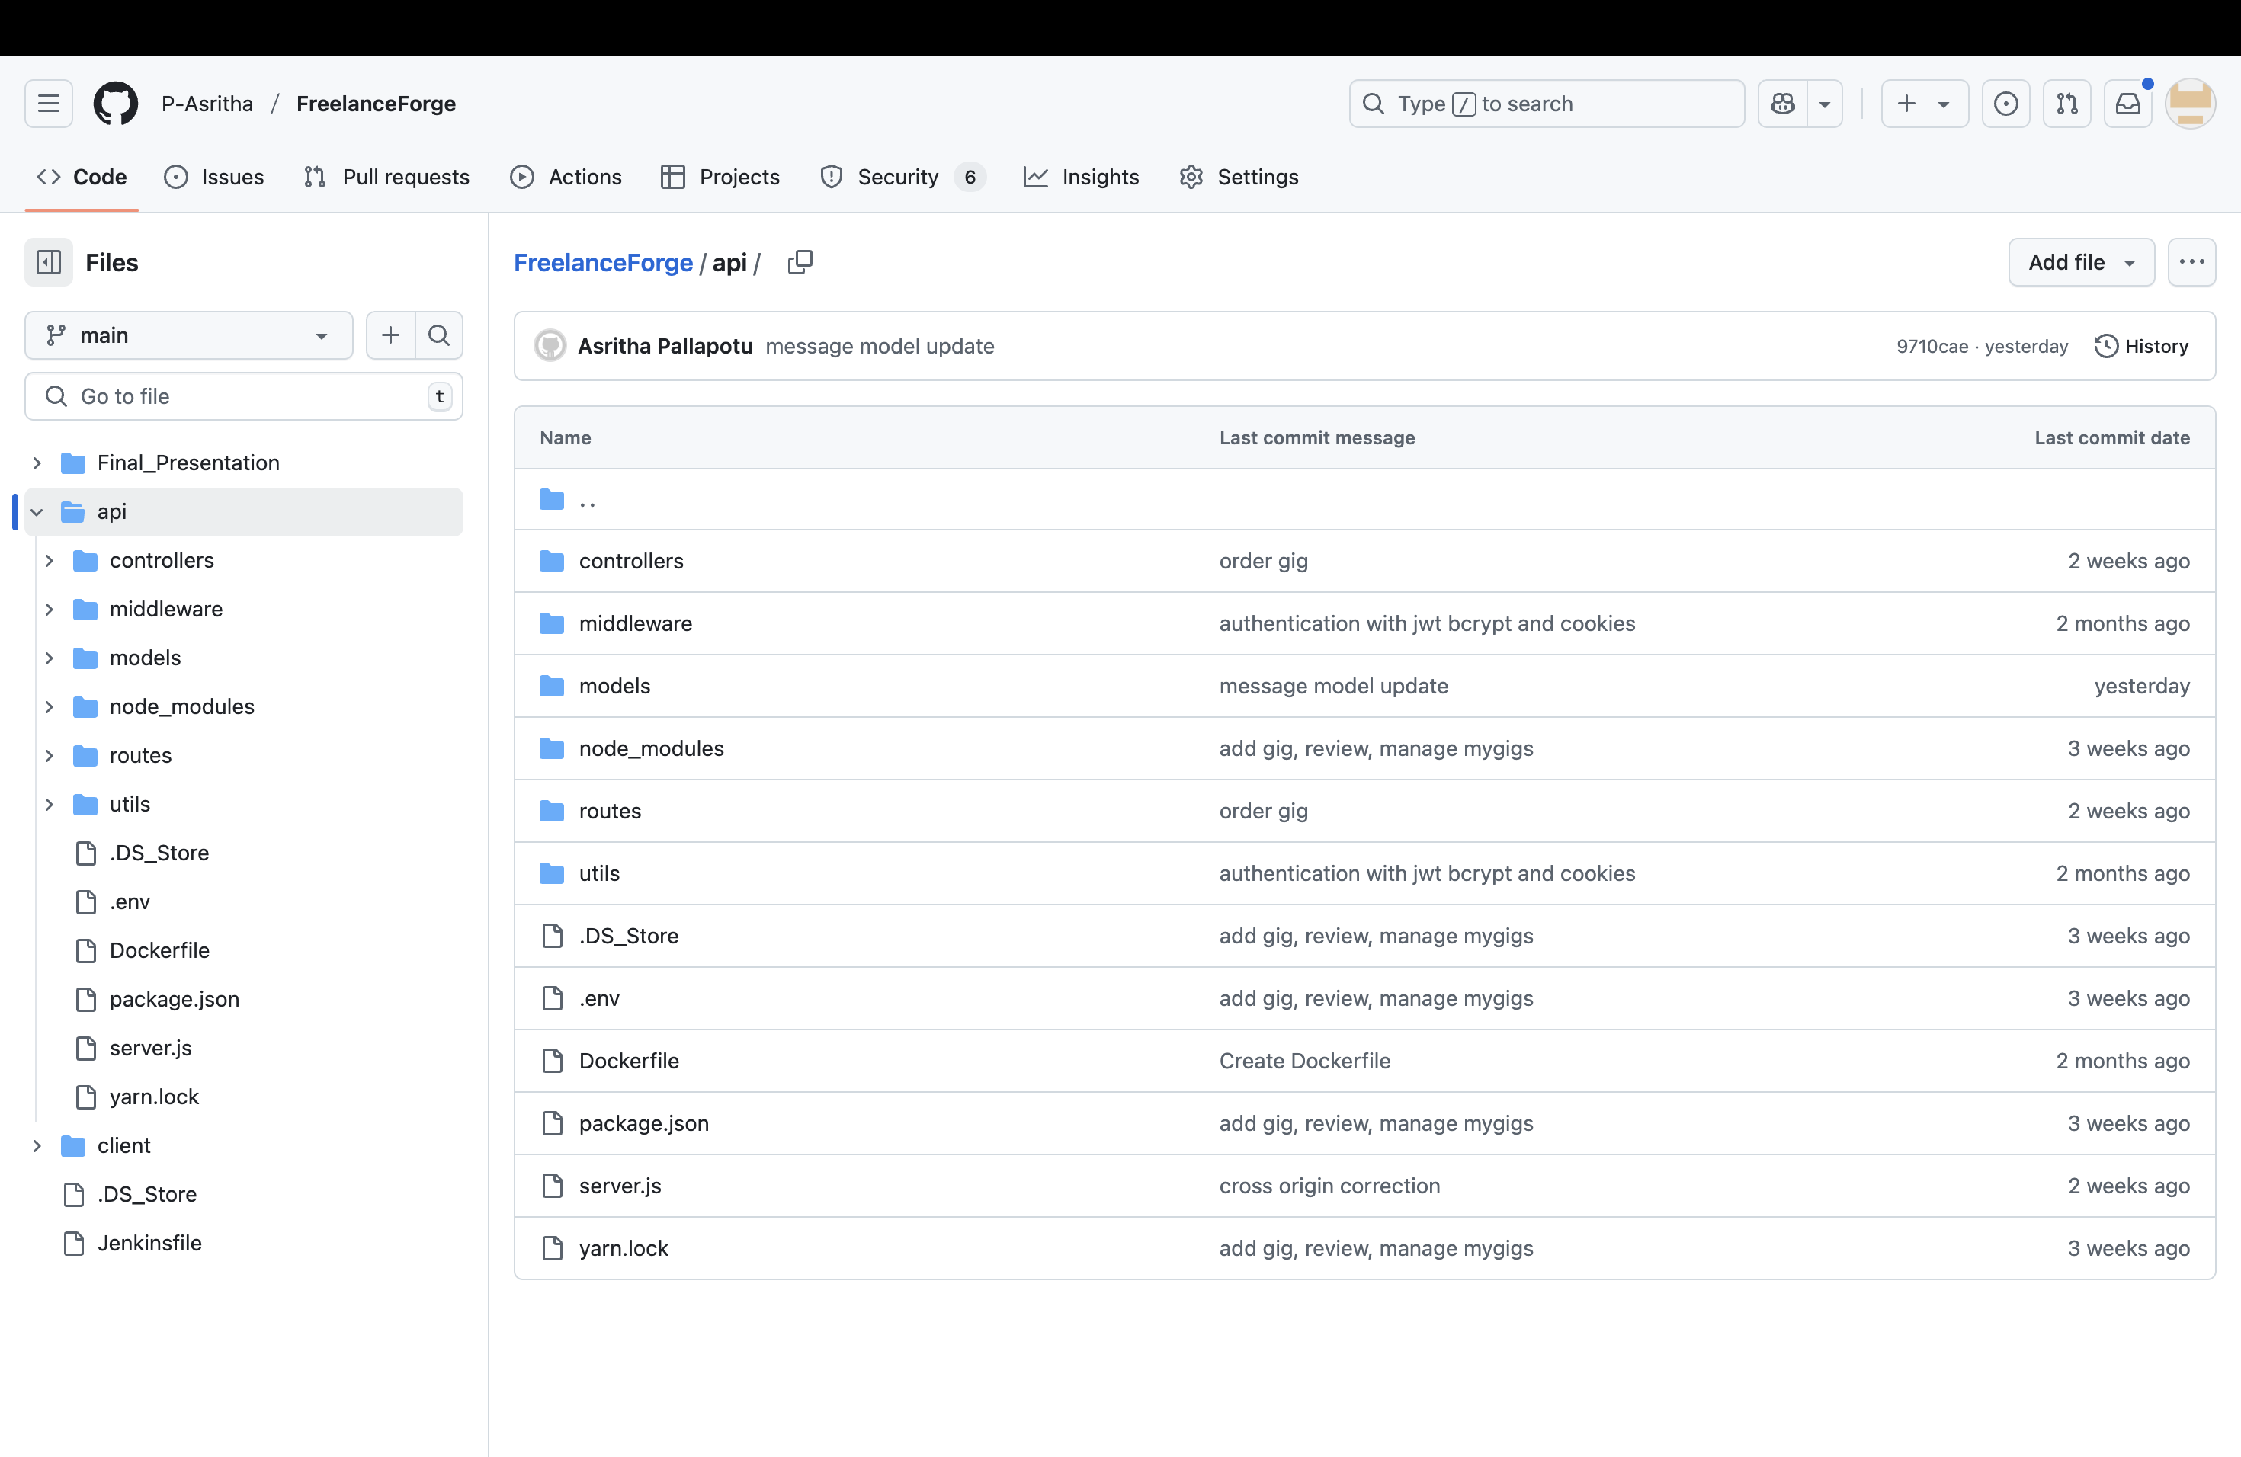
Repo Structure (API - Backend)

Slide 7
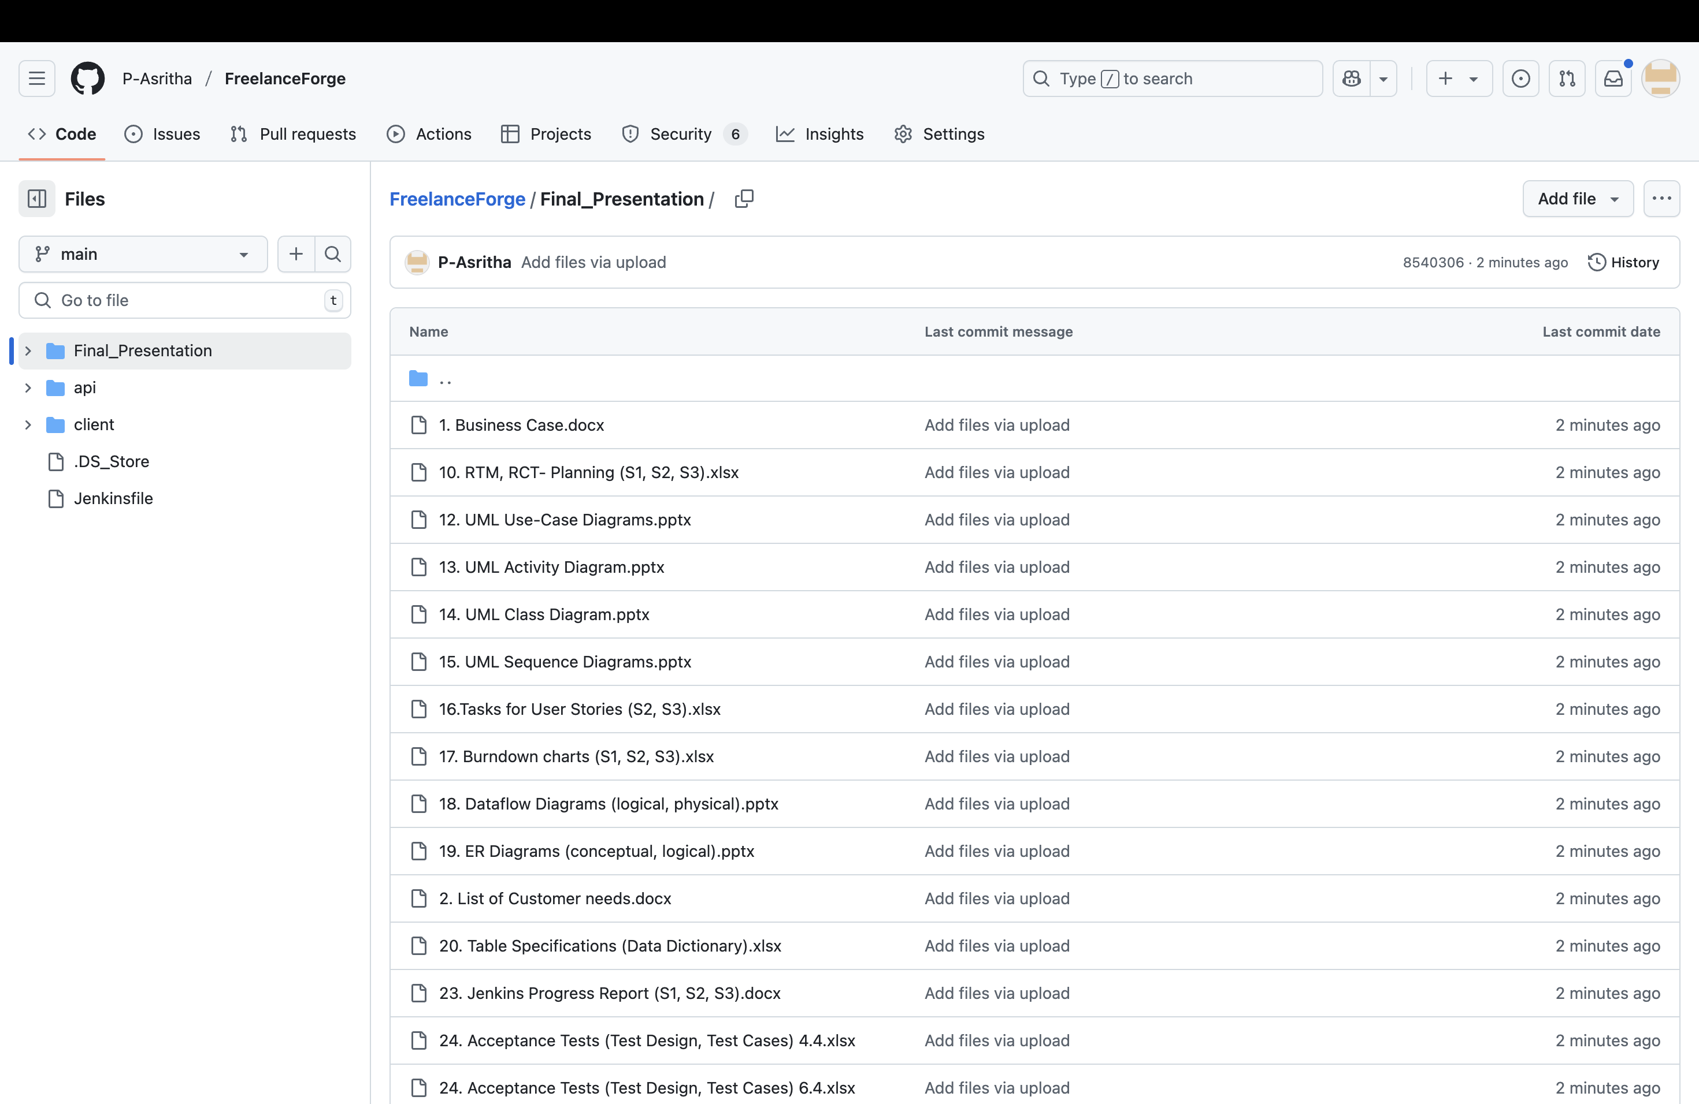
Repo Structure (Final Deliverables)

Slide 8
Prerequisite
MongoDB
Express JS
Node.js
React JS
IDEs for Frontend and Backend

Slide 9




Installation guide
Backend folder
import pom.xml as maven project
and build the project.
change the credentials of the database server on according to the local machine.
Application Home
at localhost:5173, you will land on the homepage of Freelance Forge.
Navigate through the application
and its features.
Clone the Repo
git clone <url>
Frontend folder
run the command [ npm install ]
and then [ npm start ]

Slide 10

Code Snippets

Slide 11
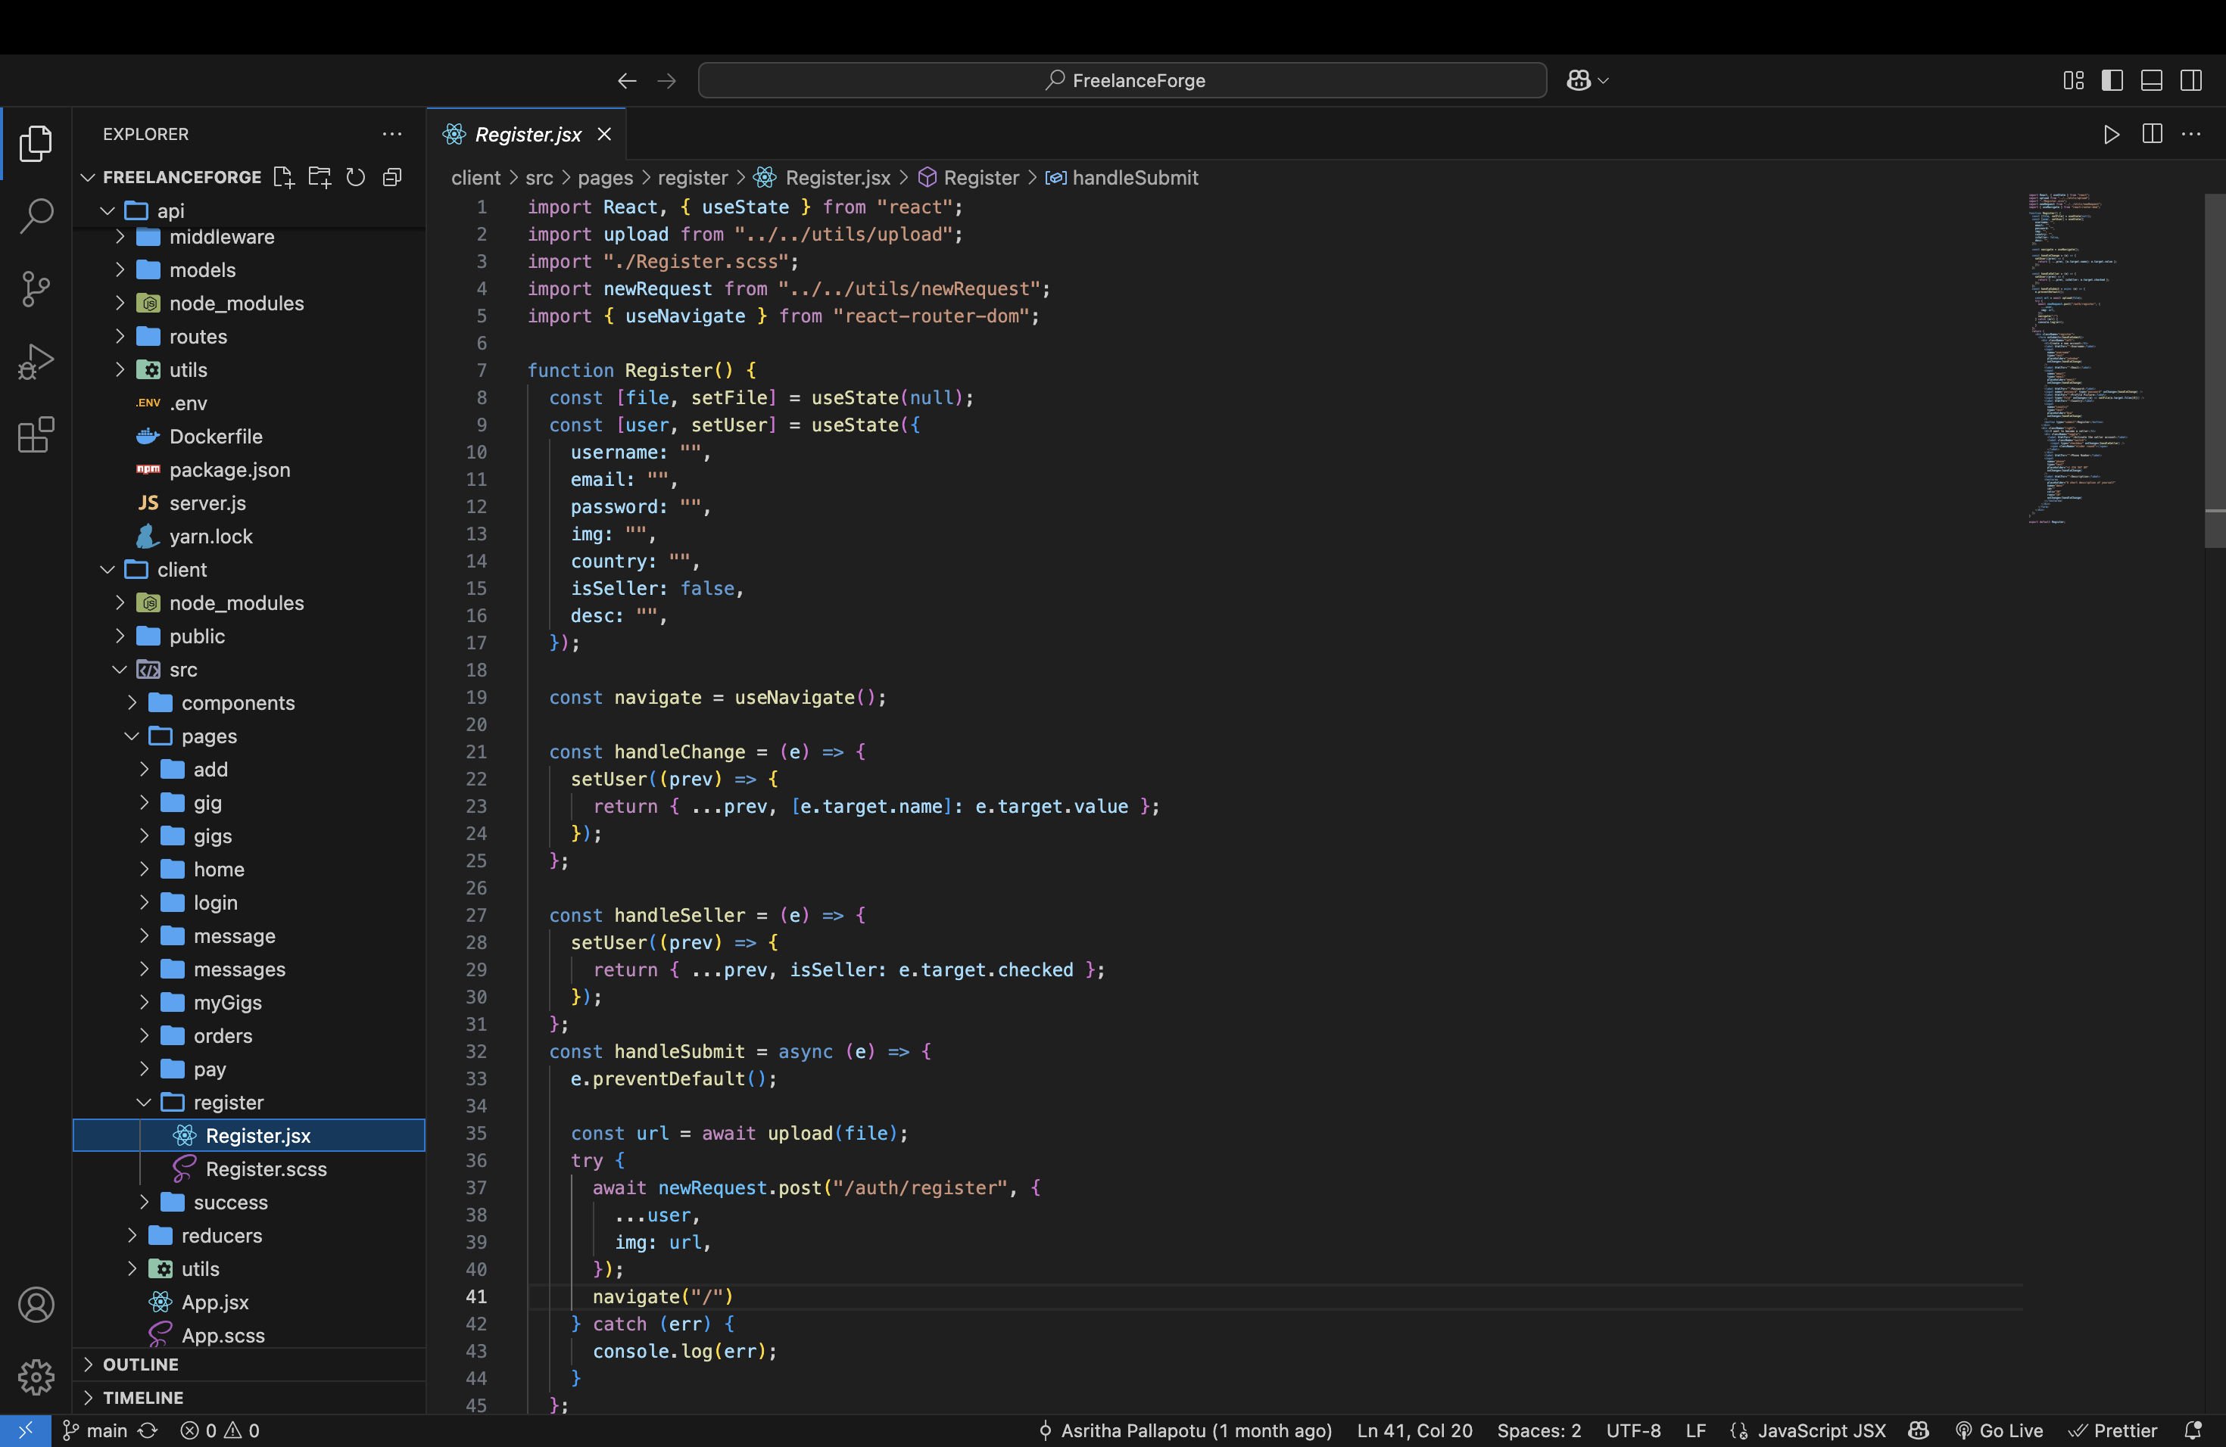
Registering(Frontend)

Slide 12
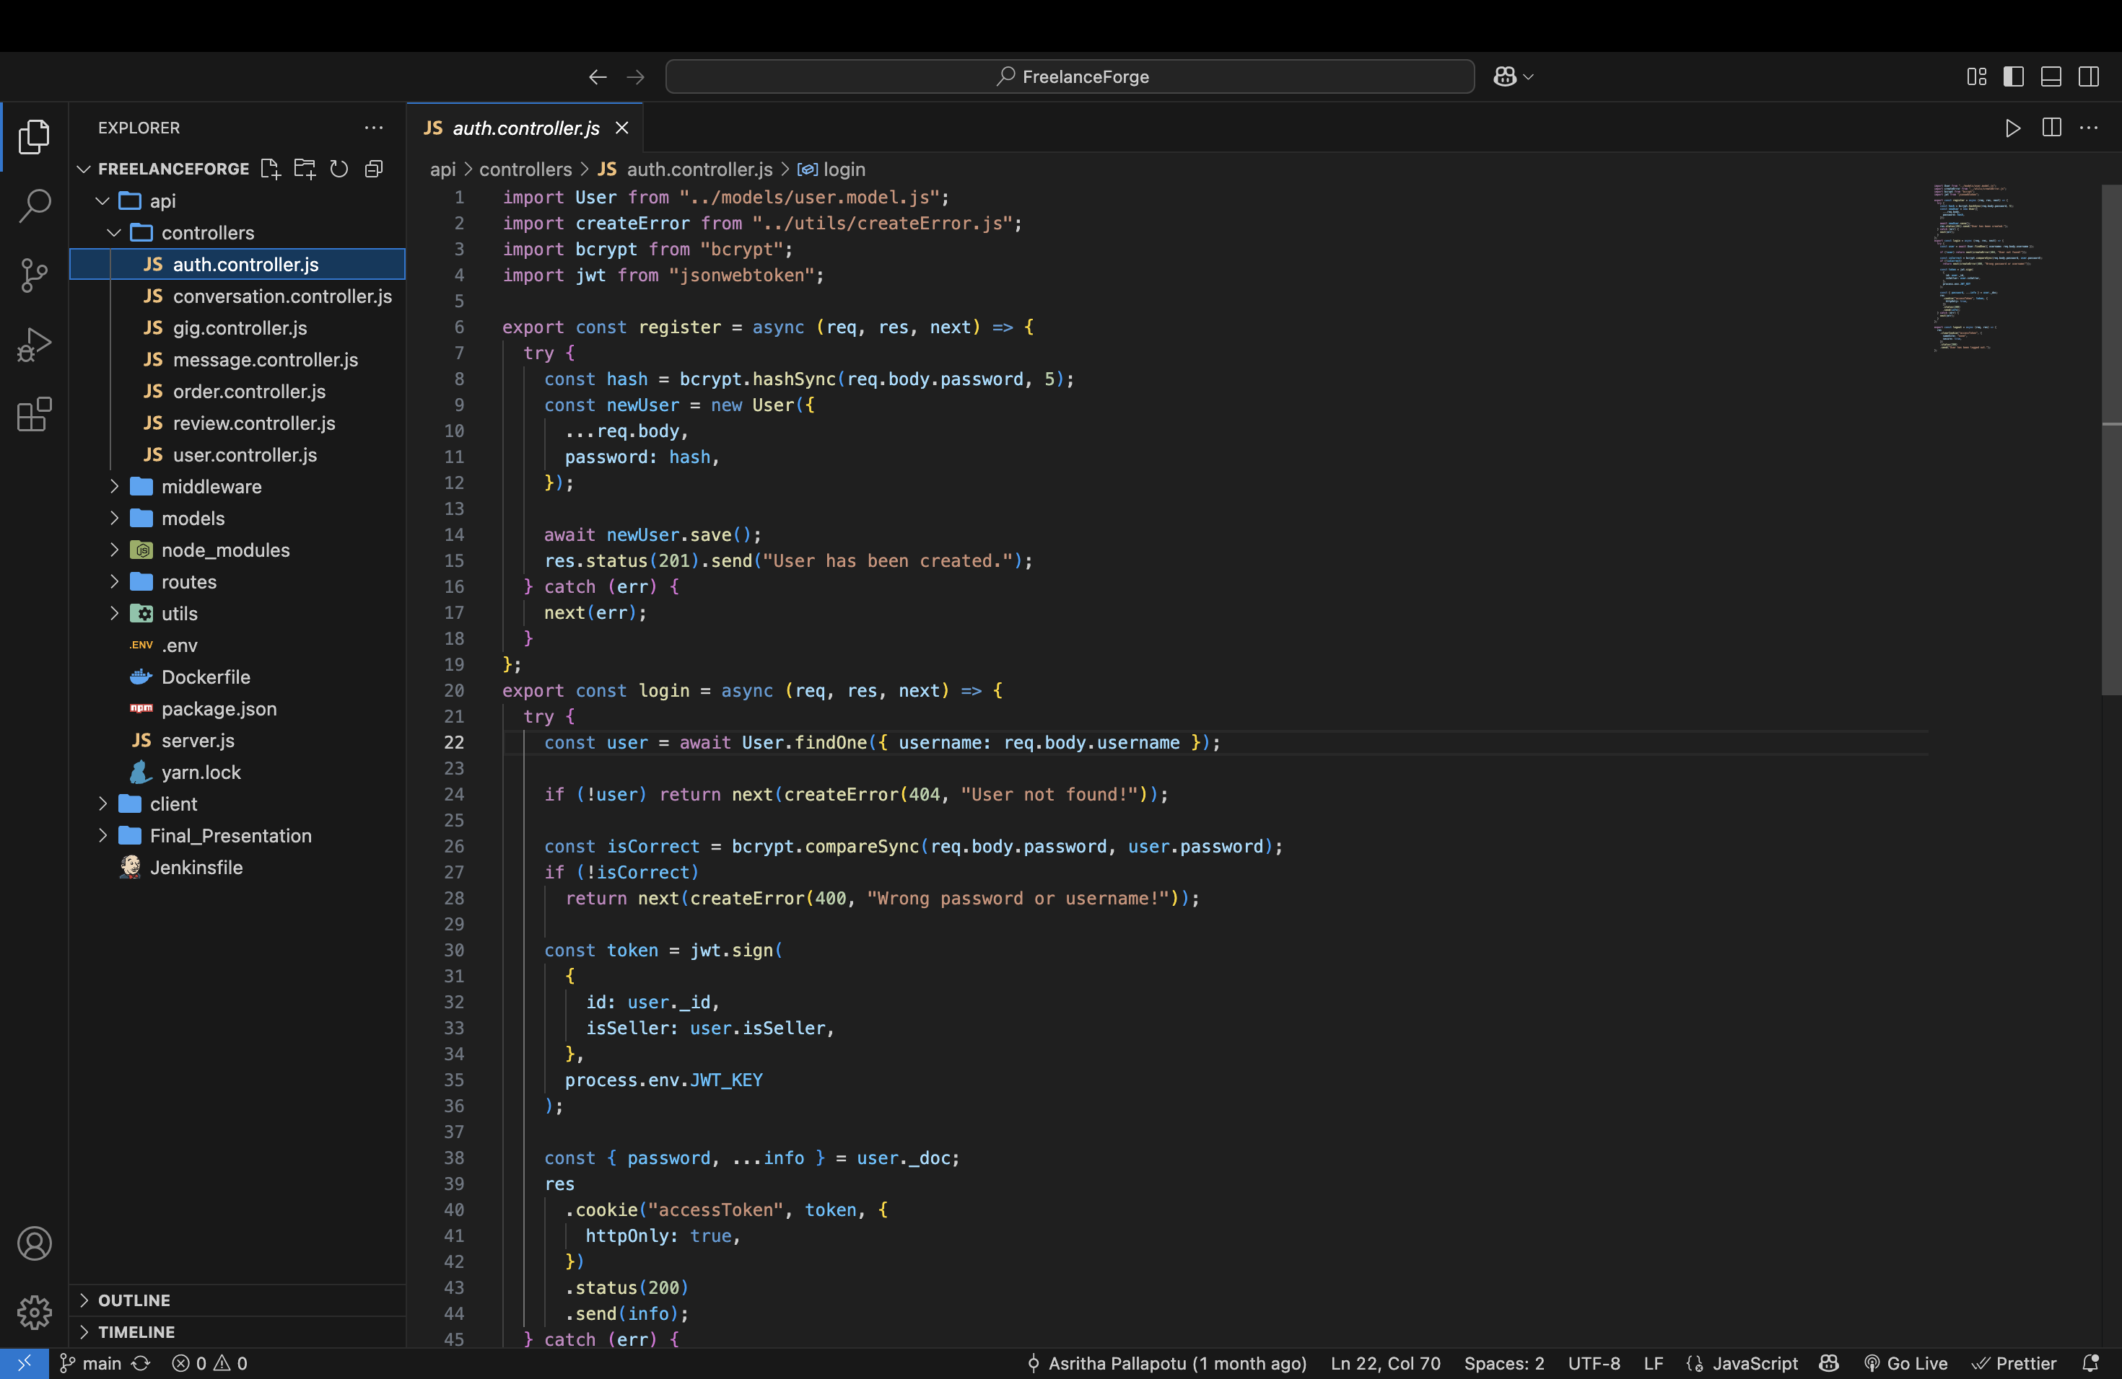
Registering(Backend)

Slide 13
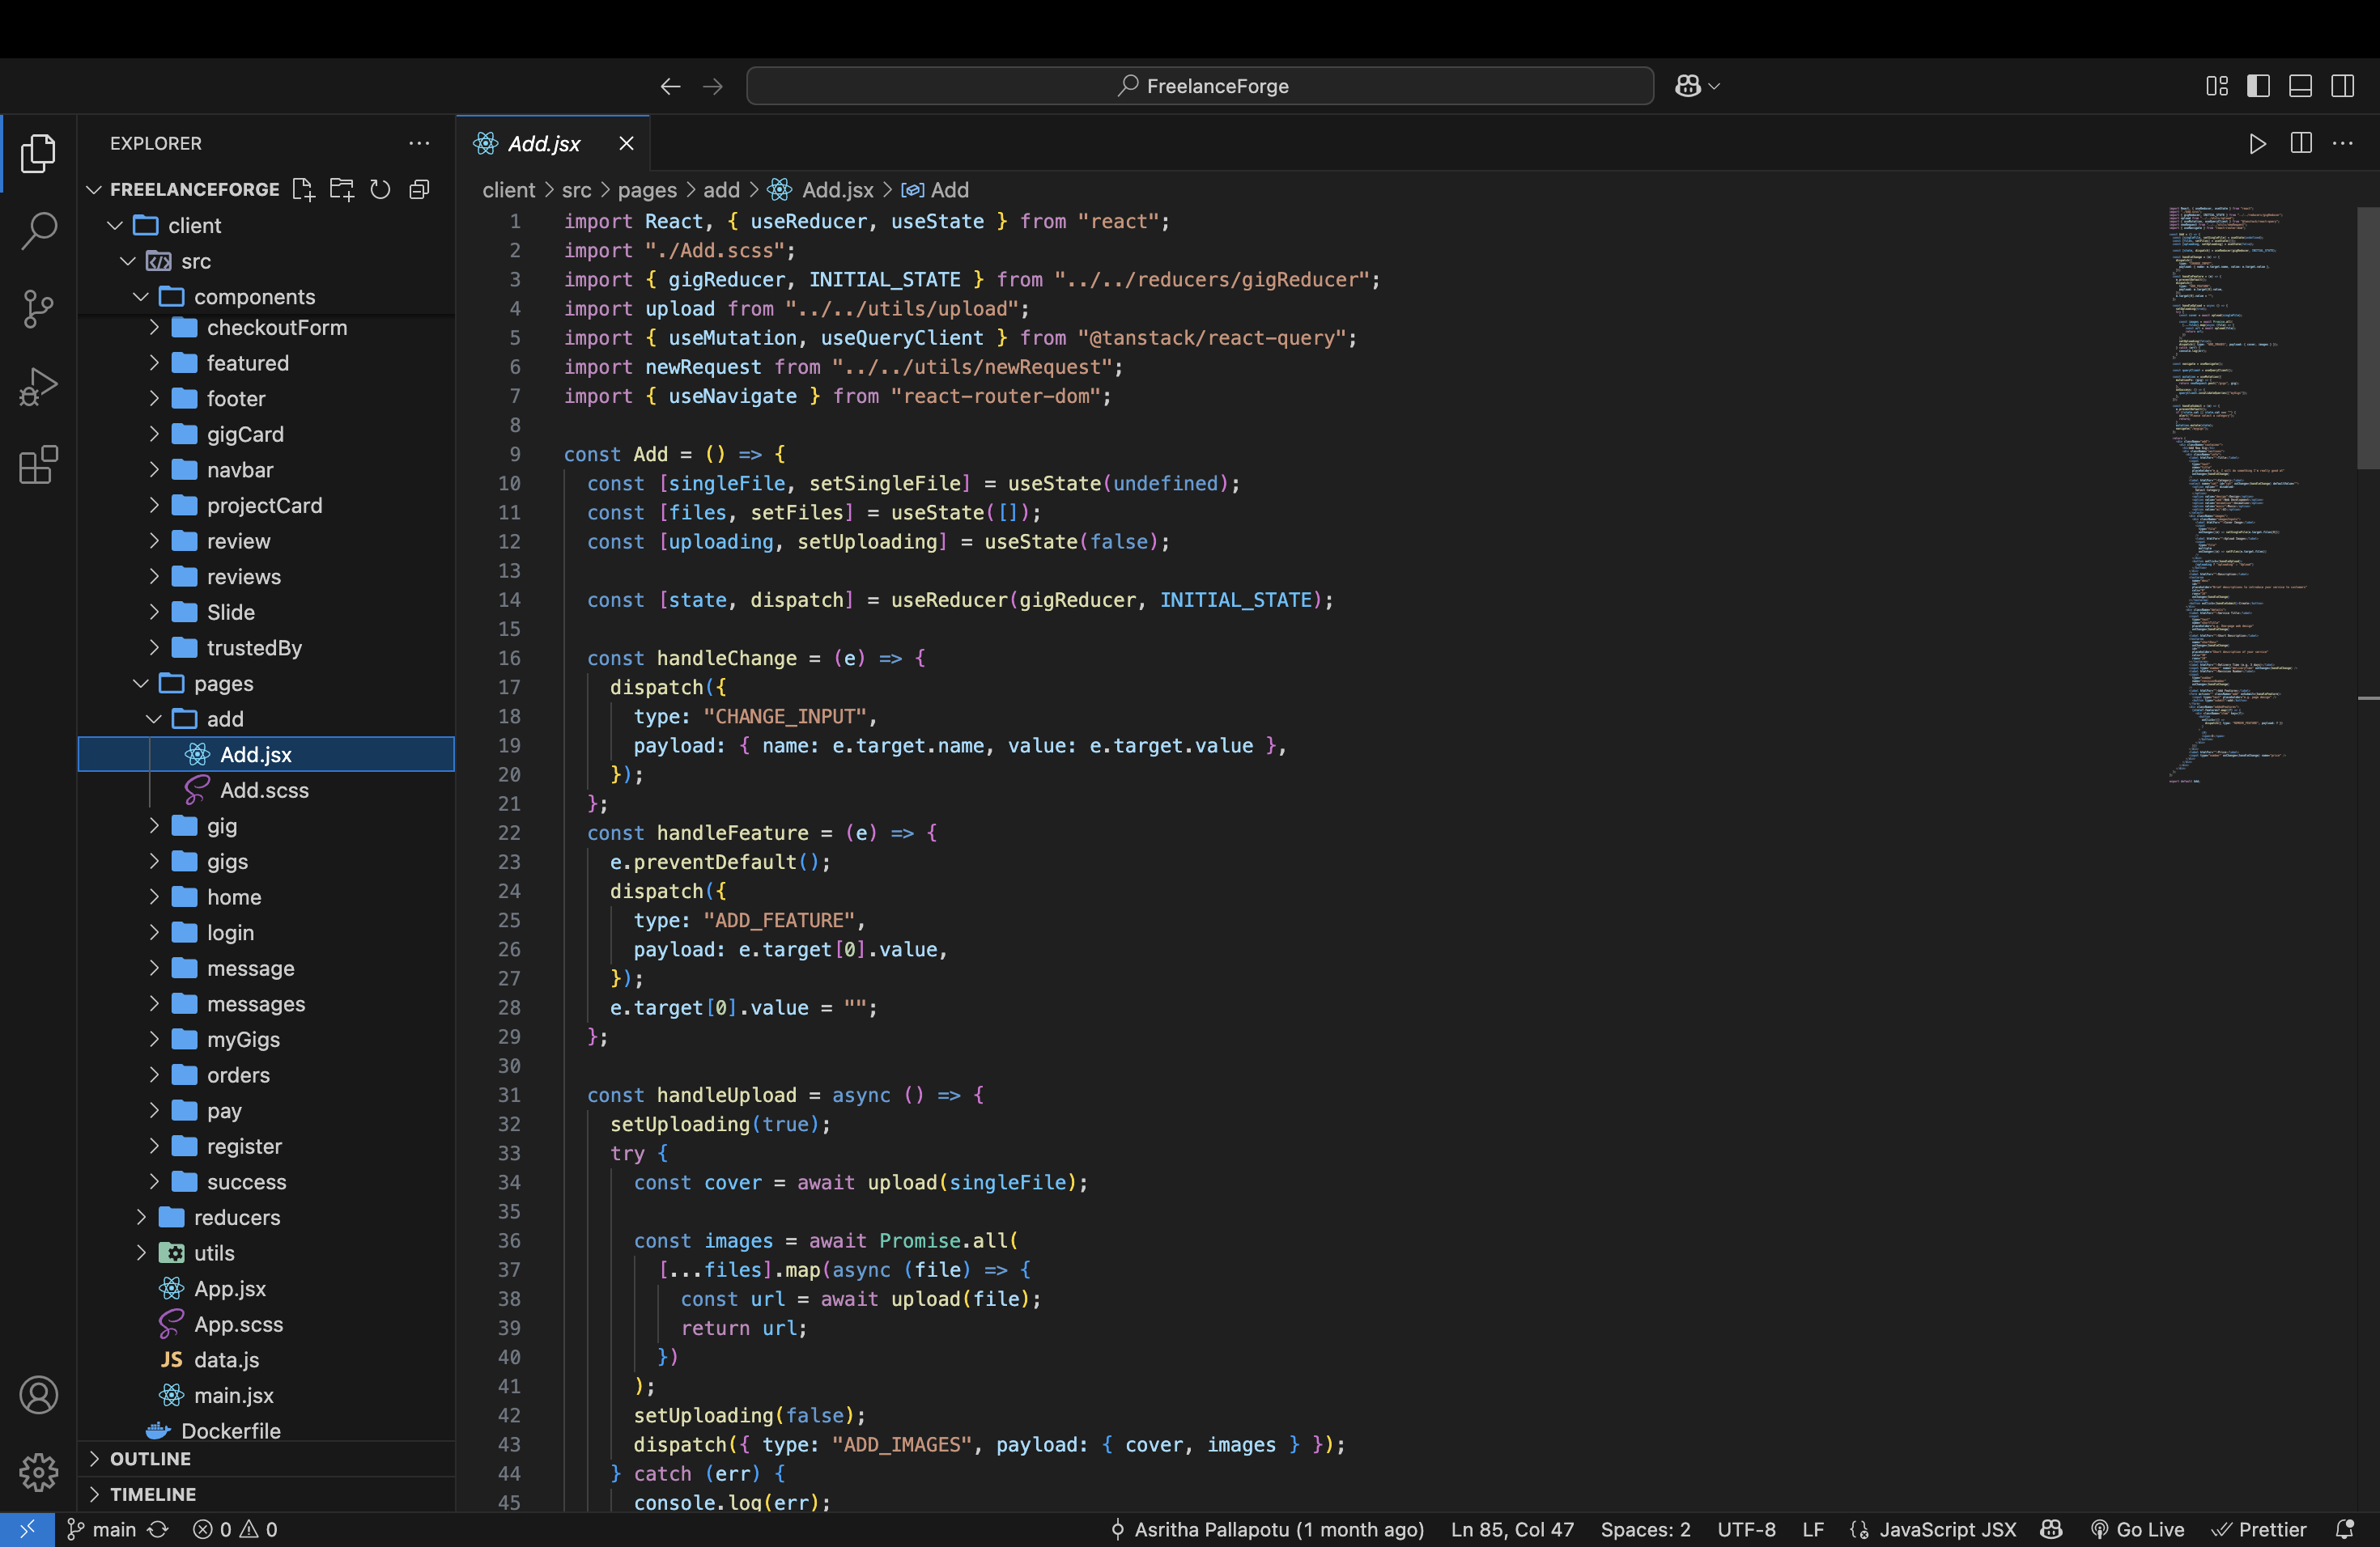
Adding Gig(Frontend)

Slide 14
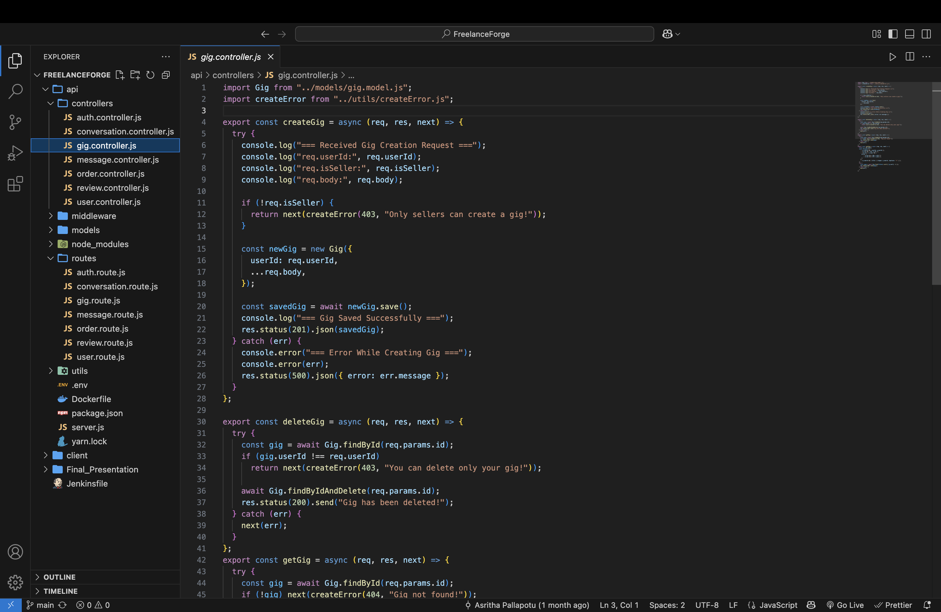
Adding Gig(Backend)

Slide 15
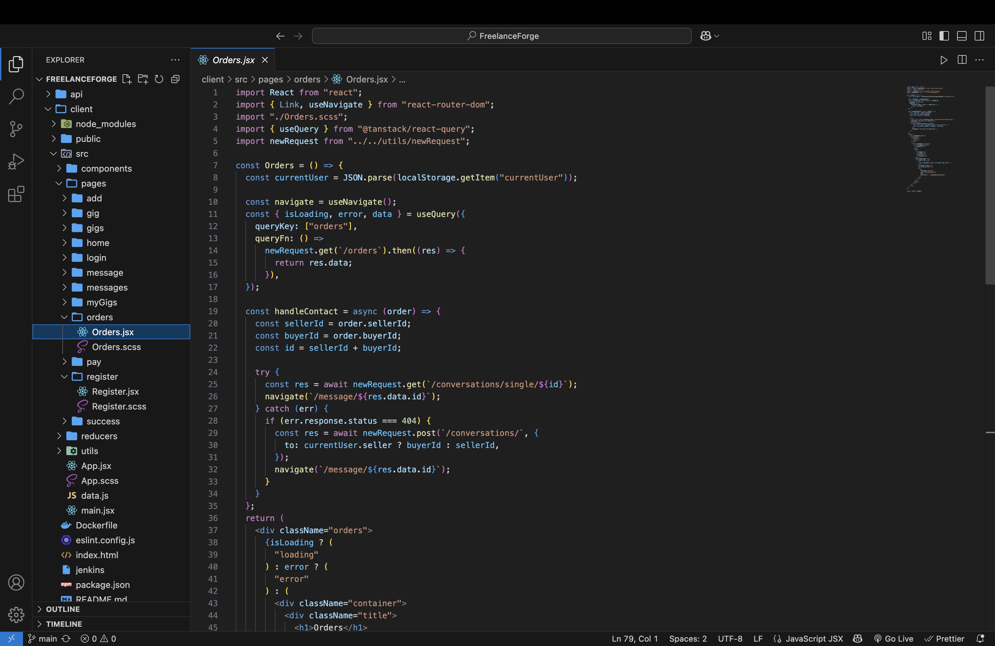
Ordering Gig(Frontend)

Slide 16
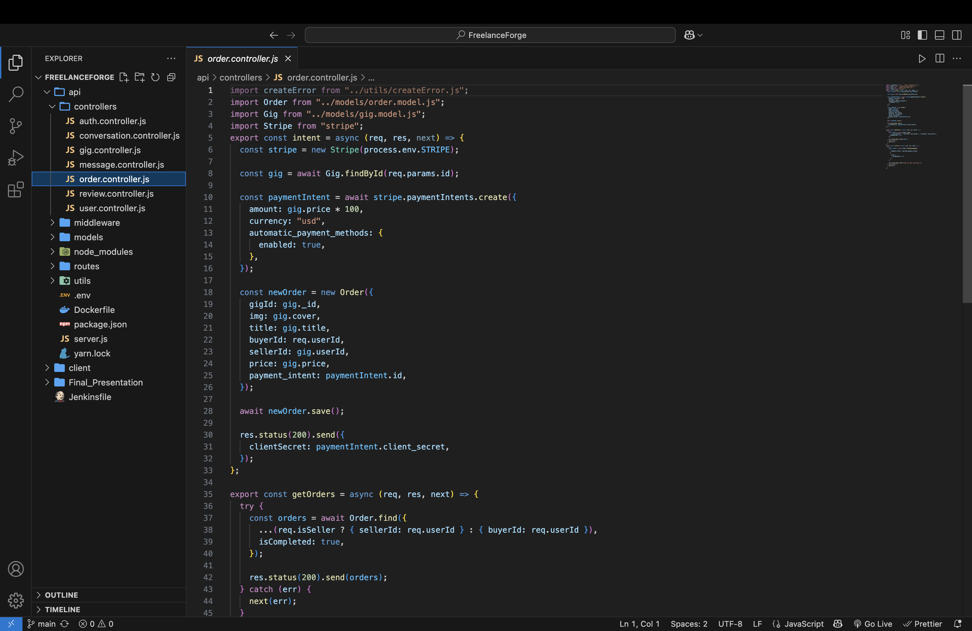
Ordering Gig(Backend)

Slide 17
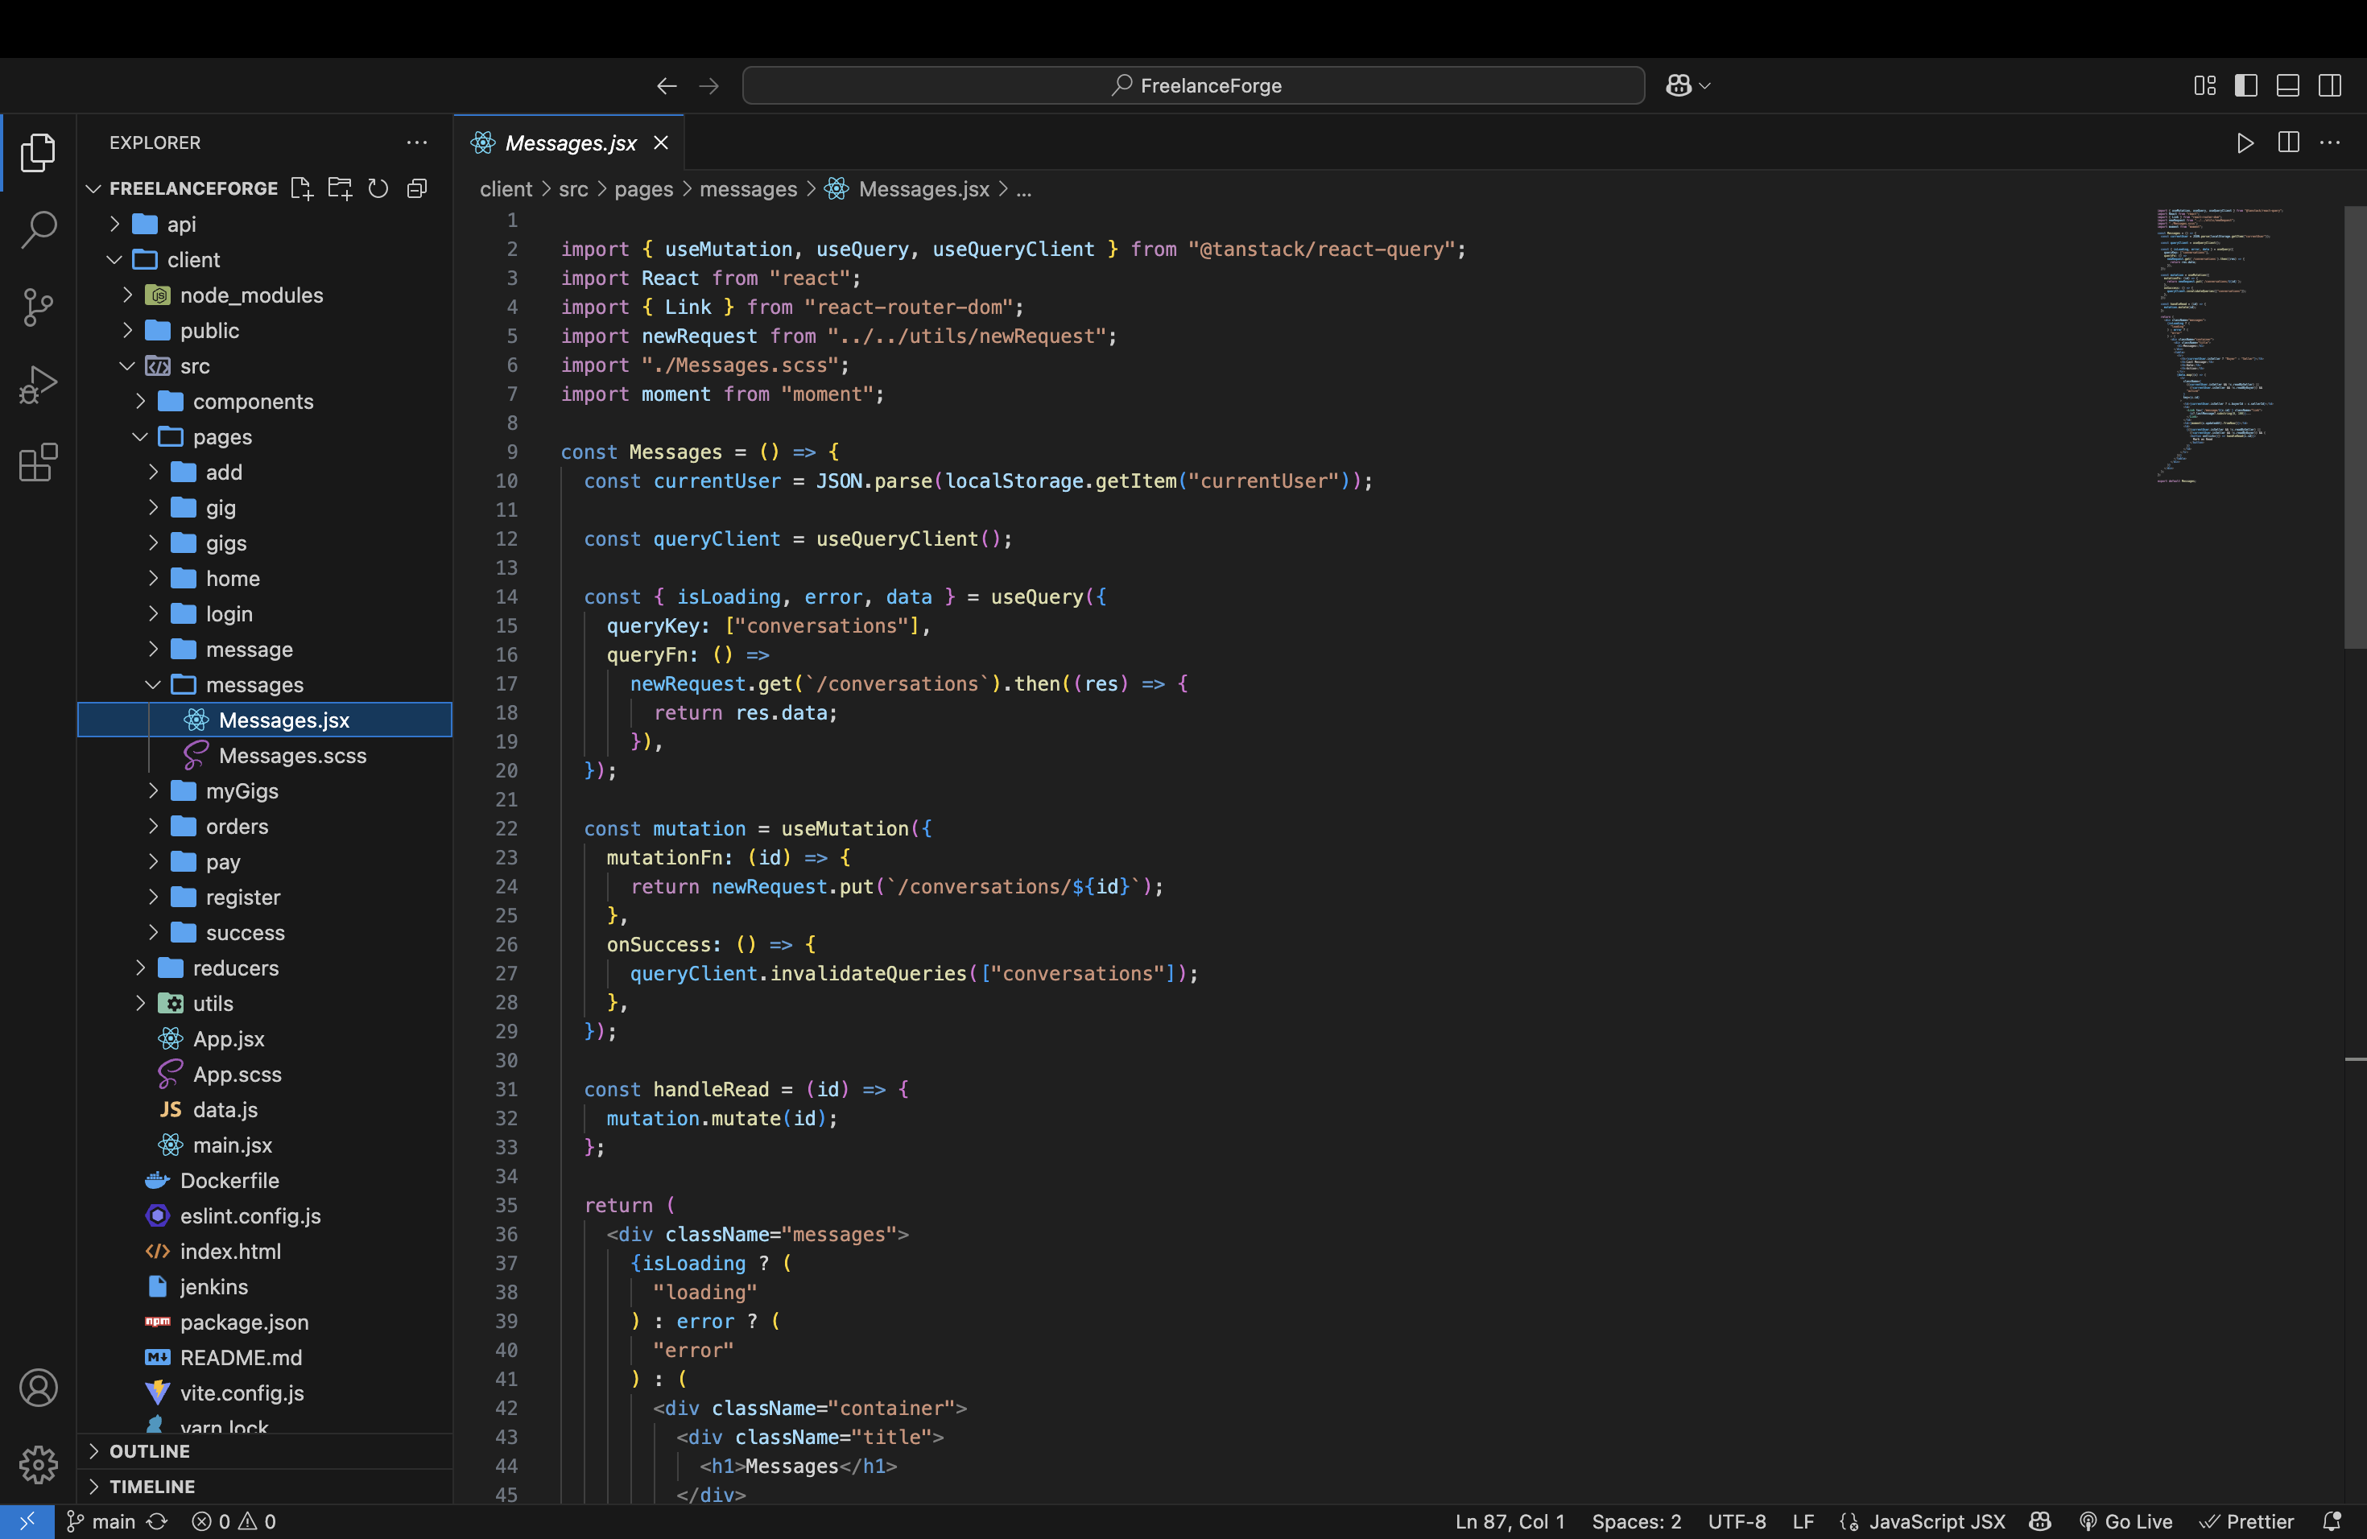
Messaging(Frontend)

Slide 18
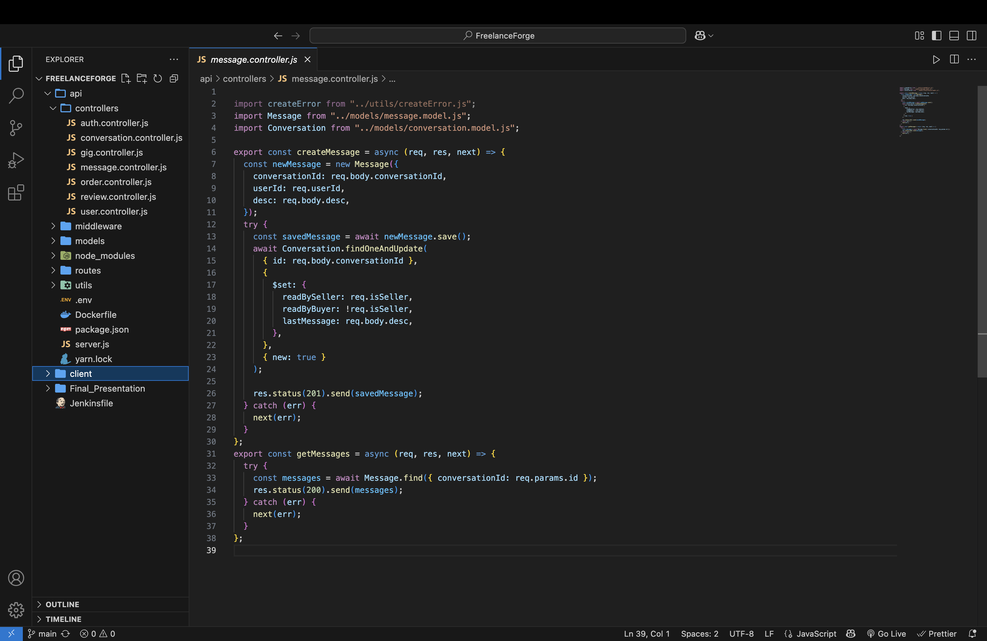
Messaging(Backend)

Slide 19
Deployment

Slide 20
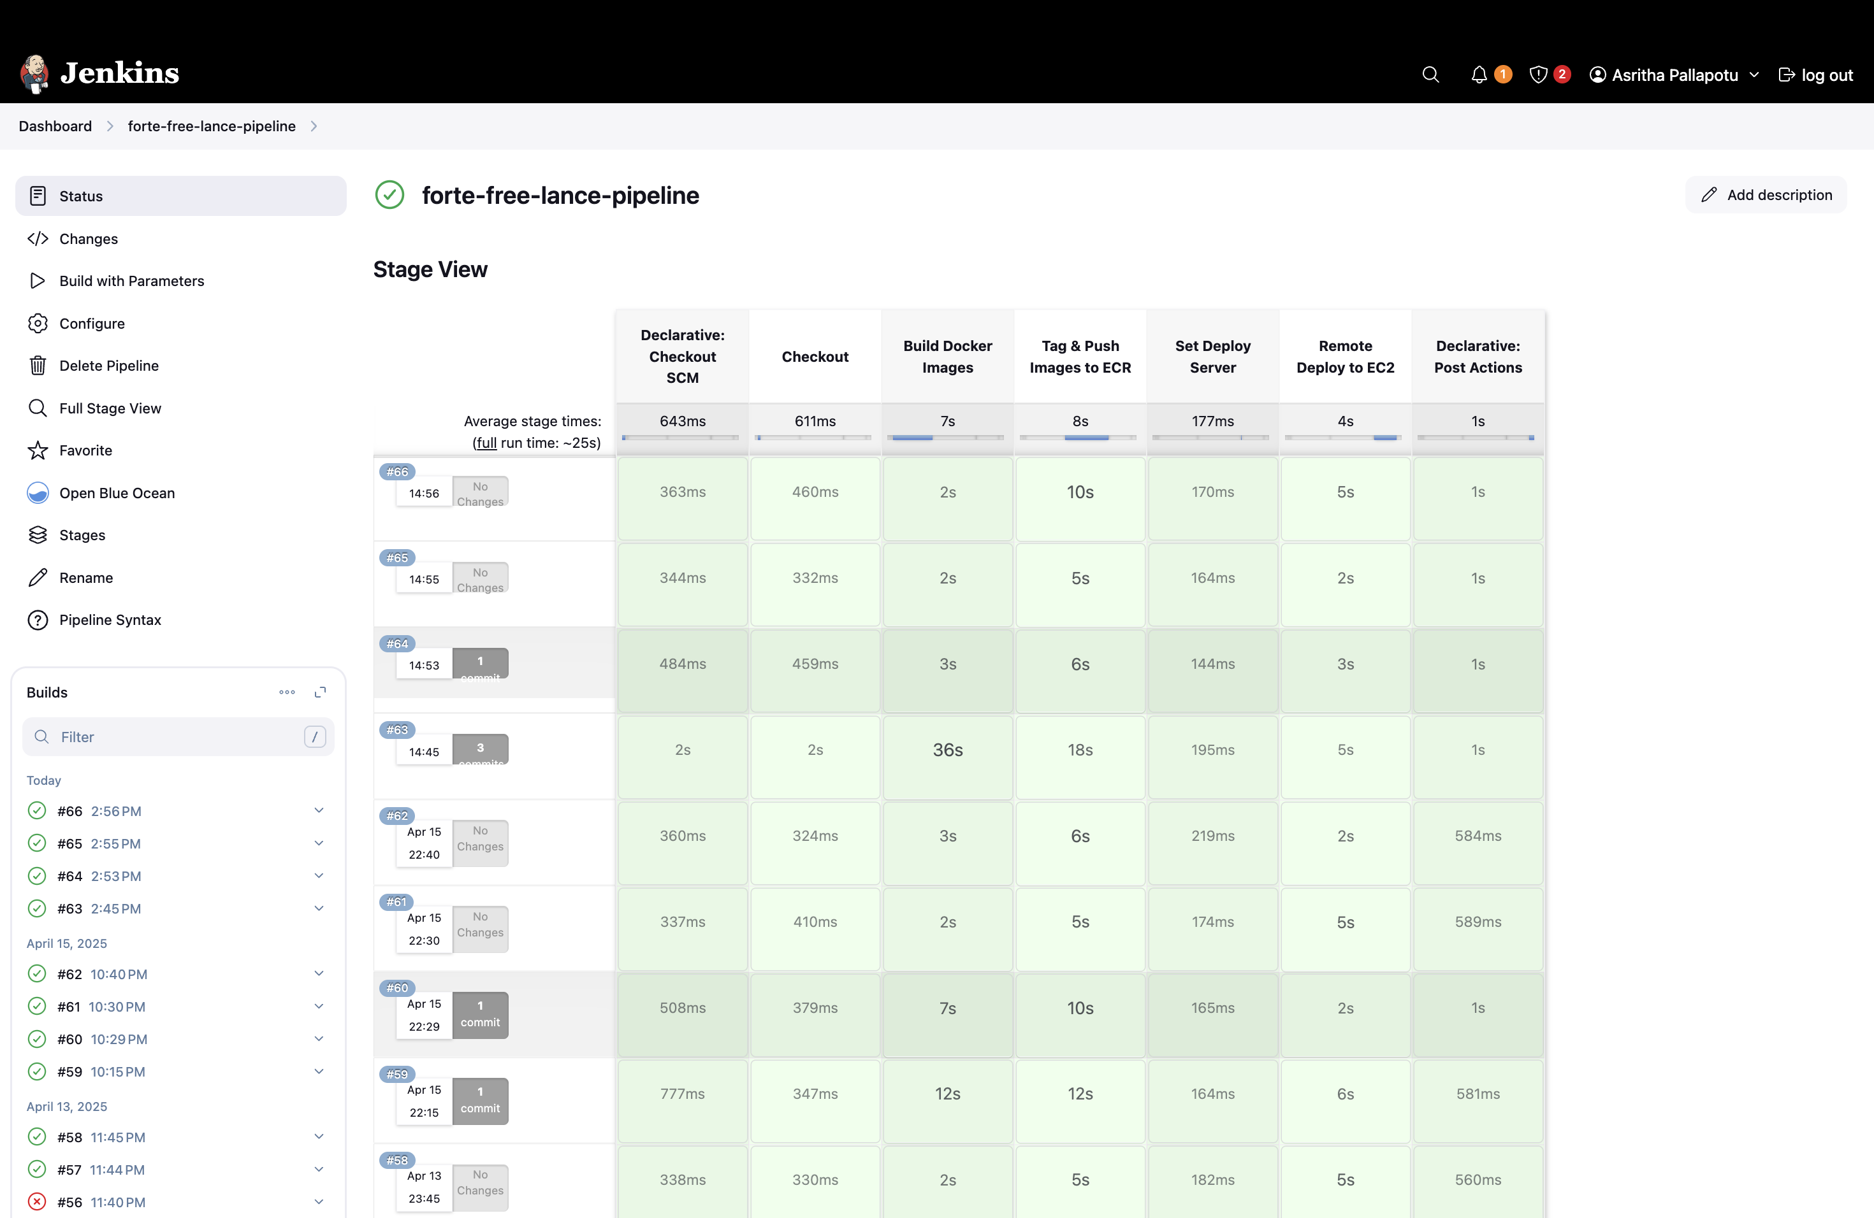
Jenkins Dashboard

Slide 21
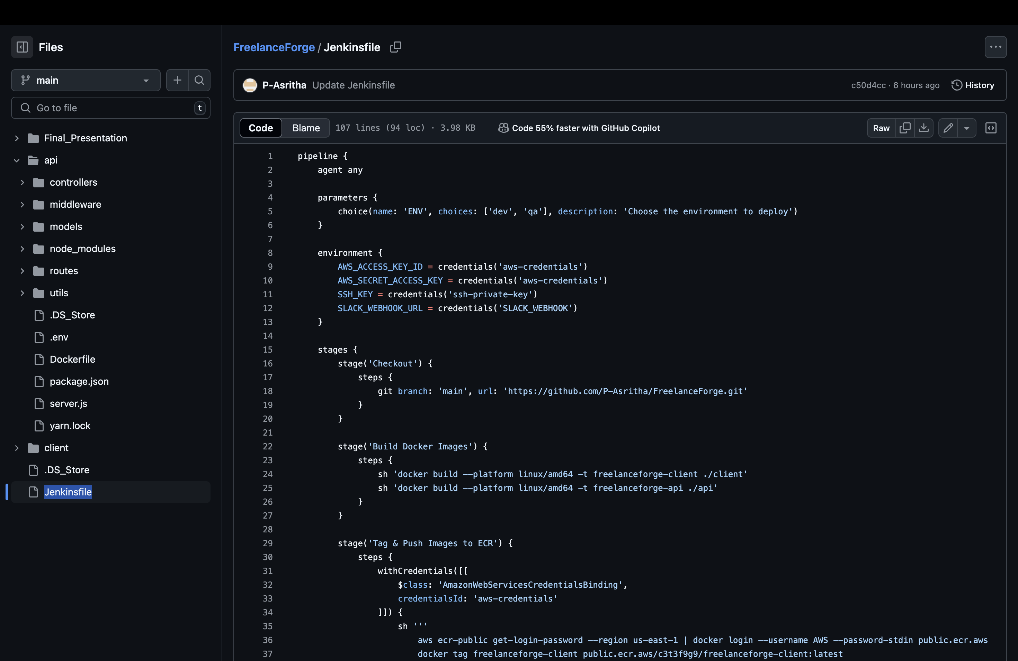
Pipeline

Slide 22
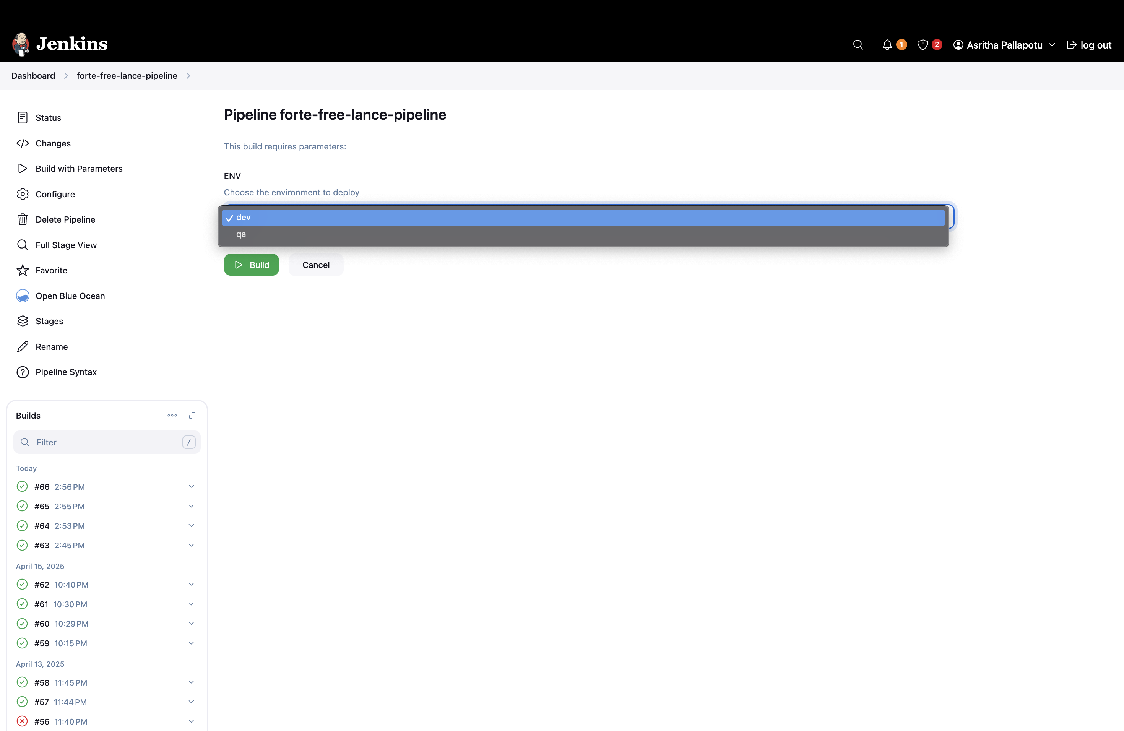
Build & Test Environment

Slide 23
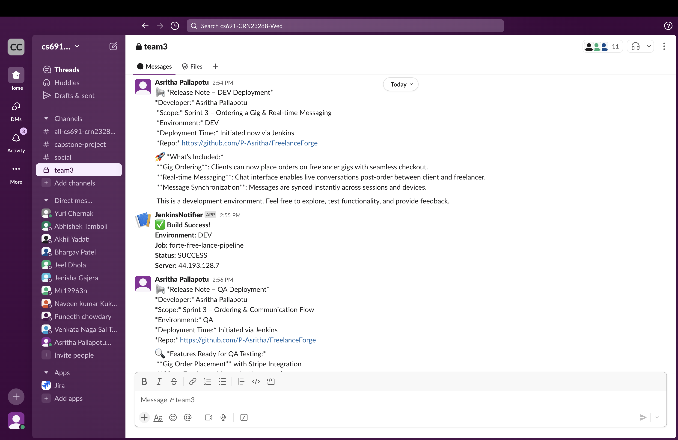
Slack Notification

Slide 24
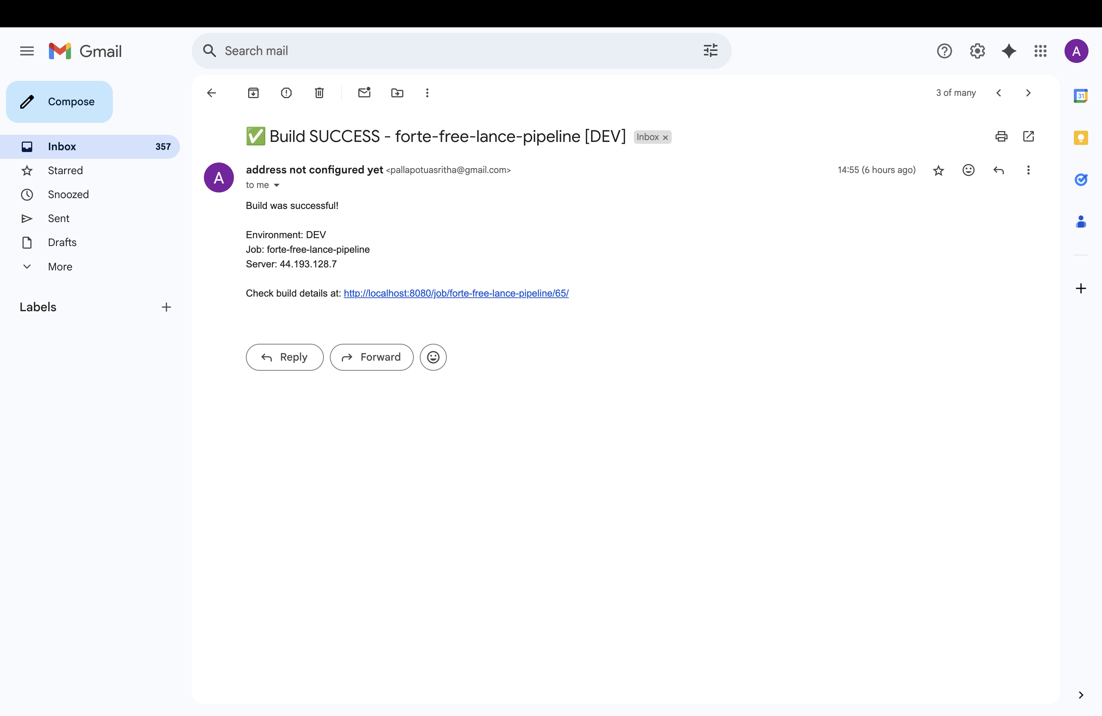
Email Notification

Slide 25
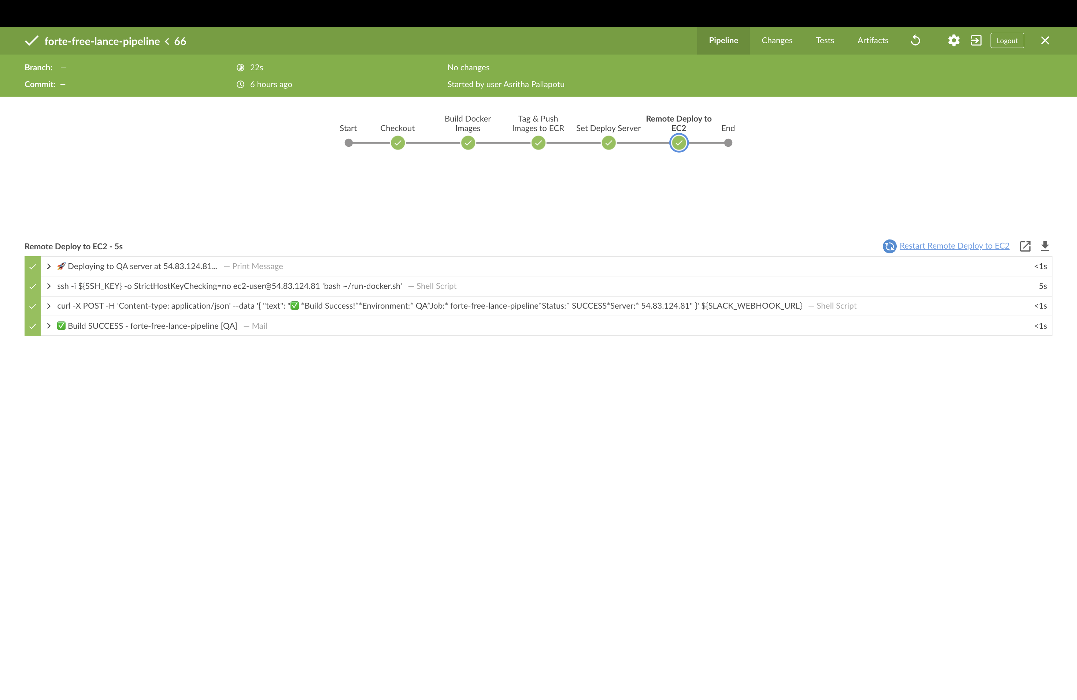
Blue Ocean Plugin

Slide 26
THANK YOU !

